Slide 1

GEO3460 – Geografiske informasjonssystemer (GIS) og geografisk datainnsamling – vår 2025
GEO3460 - Geographical Information Systems (GIS) and Geographical Data Acquisition - spring 2025
Geostatistics – kriging
Luc Girod (luc.girod@geo.uio.no)
Based on the lectures by Dr. Livia Piermattei

Slide 2
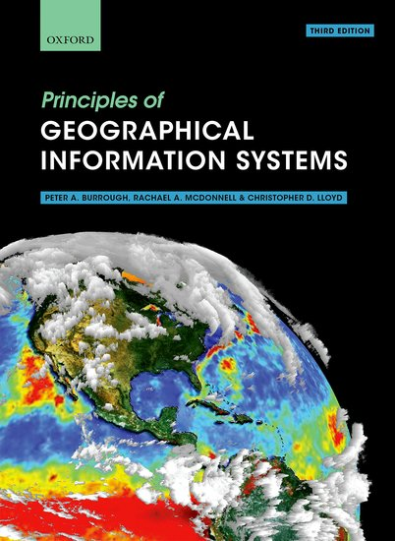
Reference text book:
“Geographical information systems”
Chapter 9

Slide 3

Learning Objectives
1
2
3
What is Geostatistics
Regionalized variable theory
Kriging
Spatial variation
Semivariogram
Basic statistic concept
Kriging in ArcGIS
Today’s topics

Slide 4
Learning Objectives
1
2
3
What is Geostatistics
Regionalized variable theory
Kriging
Spatial variation
Semivariogram
Basic statistic concept
Kriging in ArcGIS
Summary
Today’s topics

Slide 5
Interpolation algorithms
Interpolation methods allow you to construct models of reality (of the phenomenon you are interested in)
A big part of building a good model is
your understanding of the phenomenon
how the sample data was obtained
what it represents
what you expect the model to provide

Slide 6
Interpolation algorithms
Trend surfaces
Nearest neighbour (Thiessen)
Inverse distance interpolation / weighted moving average (IDW)
Spline/local polynomials
Kriging (analyses of spatial variation)

Slide 7
Interpolation algorithms
Kriging (analyses of spatial variation) are geostatistics interpolating methods to predict values at unmeasured points across the domain.
what was the major disadvantage of the IDW method?
We discussed this earlier this week
Notes:
Many interpolation methods exist.
Some are quite flexible and can accommodate different aspects of the sample data. Others are more restrictive and require that the data meet specific conditions.

Slide 8
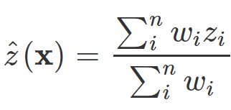
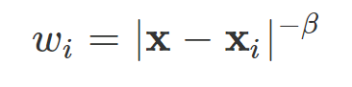
Interpolation algorithms
Kriging (analyses of spatial variation) is geostatistics interpolating methods to predict values at unmeasured points across the domain.
what was the major disadvantage of the IDW method?
We discussed this earlier this week ….
where
where:
β ≥0
β is the inverse distance power (or power coefficient)
|x-x_{i}| is the euclidean distance
n is the number of surrounding points to be included
Notes:
DISCUSS
3 things mainly:
Power coefficient for whole area (beta).
Number of points that should be included for the interpolation of each point in the whole area (n).
No evaluation of accuracy.
Many interpolation methods exist.
Some are quite flexible and can accommodate different aspects of the sample data. Others are more restrictive and require that the data meet specific conditions.
Local interpolation
Exact interpolation

Slide 9
How interpolate
Deterministic methods:
Deterministic models use a mathematical function to predict unknown values and result in hard classification of the value of features.
Example: splines, IDW, Natural Neighbour, Trend
Statistical (geostatistical) methods:
Statistical techniques are based on statistical models that include autocorrelation: the statistical relationship among the measured points.
Observations have a dependence in space (spatial variability)
→ Regionalized variable theory
Provide some measure of the accuracy of the predictions.
Example: kriging
Notes:
There are effectively two types of techniques for generating raster surfaces.
The interpolation tools are generally divided into deterministic and geostatistical methods.
The deterministic interpolation methods assign values to locations based on the surrounding measured values and on specified mathematical formulas that determine the smoothness of the resulting surface.
The deterministic methods include IDW (inverse distance weighting), Natural Neighbor, Trend, and Spline.
The geostatistical methods are based on statistical models that include autocorrelation (the statistical relationship among the measured points). Because of this, geostatistical techniques not only have the capability of producing a prediction surface but also provide some measure of the certainty or accuracy of the predictions.
Kriging is a geostatistical method of interpolation.
They are more difficult to execute since more parameters need to be set.
There are two main groupings of interpolation techniques: deterministic and geostatistical. Deterministic interpolation techniques create surfaces from measured points, based on either the extent of similarity (Inverse Distance Weighted) or the degree of smoothing (Radial Basis Functions). Geostatistical interpolation techniques (kriging) utilize the statistical properties of the measured points. Geostatistical techniques quantify the spatial autocorrelation among measured points and account for the spatial configuration of the sample points around the prediction location.

Slide 10
Geostatistics
Geostatistics
It is a class of statistics used to analyze and predict the values associated with spatial or spatiotemporal phenomena.
It incorporates the spatial (and in some cases temporal) coordinates of the data within the analyses.
Geostatistical tools and methods provide interpolated values and measures of uncertainty for those values
The measurement of uncertainty provides information on the possible values (outcomes) for each location rather than just one interpolated value
Notes:
The measurement of uncertainty is critical to informed decision making, as it provides information on the possible values (outcomes) for each location rather than just one interpolated value.
Geostatistical tools and methods have since evolved to not only provide interpolated values, but also measures of uncertainty for those values

Slide 11
Geostatistics
Geostatistics: assumptions
Geostatistical methods were developed for interpreting data that varies continuously over a predefined, fixed spatial region.
The study of Geostatistics assumes that at least some of the spatial variation observed for natural phenomena can be modeled by random processes with spatial autocorrelation.
It is based on the theory of regionalized variables, variable distributed in space (or time).
Notes:
Geostatistics is a class of statistics used to analyze and predict the values associated with spatial or spatiotemporal phenomena.
Geostatistical theory supports that any measurement of regionalized variables can be viewed as a realization of a random function (or random process, or random field, or stochastic process).

Slide 12
Geostatistics: Spatial variability
Spatial autocorrelation:
presence of systematic spatial variation in a variable
positive spatial autocorrelation is the tendency for areas or sites that are close together to have similar values.
“Everything in the universe is related to everything else, but closer things are more related.” – Tobler’s First Law of Geography
Notes:
Spatial autocorrelation is the tendency for areas or sites that are close together to have similar values.
We come back to the The first law of geography: Everything is related to everything else, but near things are more related than distant things.” Waldo R. Tobler (Tobler 1970)

Slide 13
Geostatistics: Spatial variability
Examples of spatially dependent variables (regionalized variables)
Rainfall
Soil’s hydraulic conductivity
Chemical concentration
Plant properties
Slope
Temperature
Population characteristics
…
Is elevation a spatially autocorrelated variable?
Notes:
DISCUSS
Variables that vary gradually over space, thus forming a smooth gradient of a variable between two locations in space.
The propensity of a variable to show a smooth gradient across space aggregates similar values or properties adjacent to each other.
land surface elevation values of adjacent locations are generally quite similar
Spatial autocorrelation is a property of a variable that is often distributed over space
In classical statistics, the observed samples are assumed to be independent and identically distributed. This assumption is no longer valid for inherently spatially autocorrelated data.
This fact suggests that classical statistical tools like linear regression are inappropriate for spatial data analysis.

Slide 14
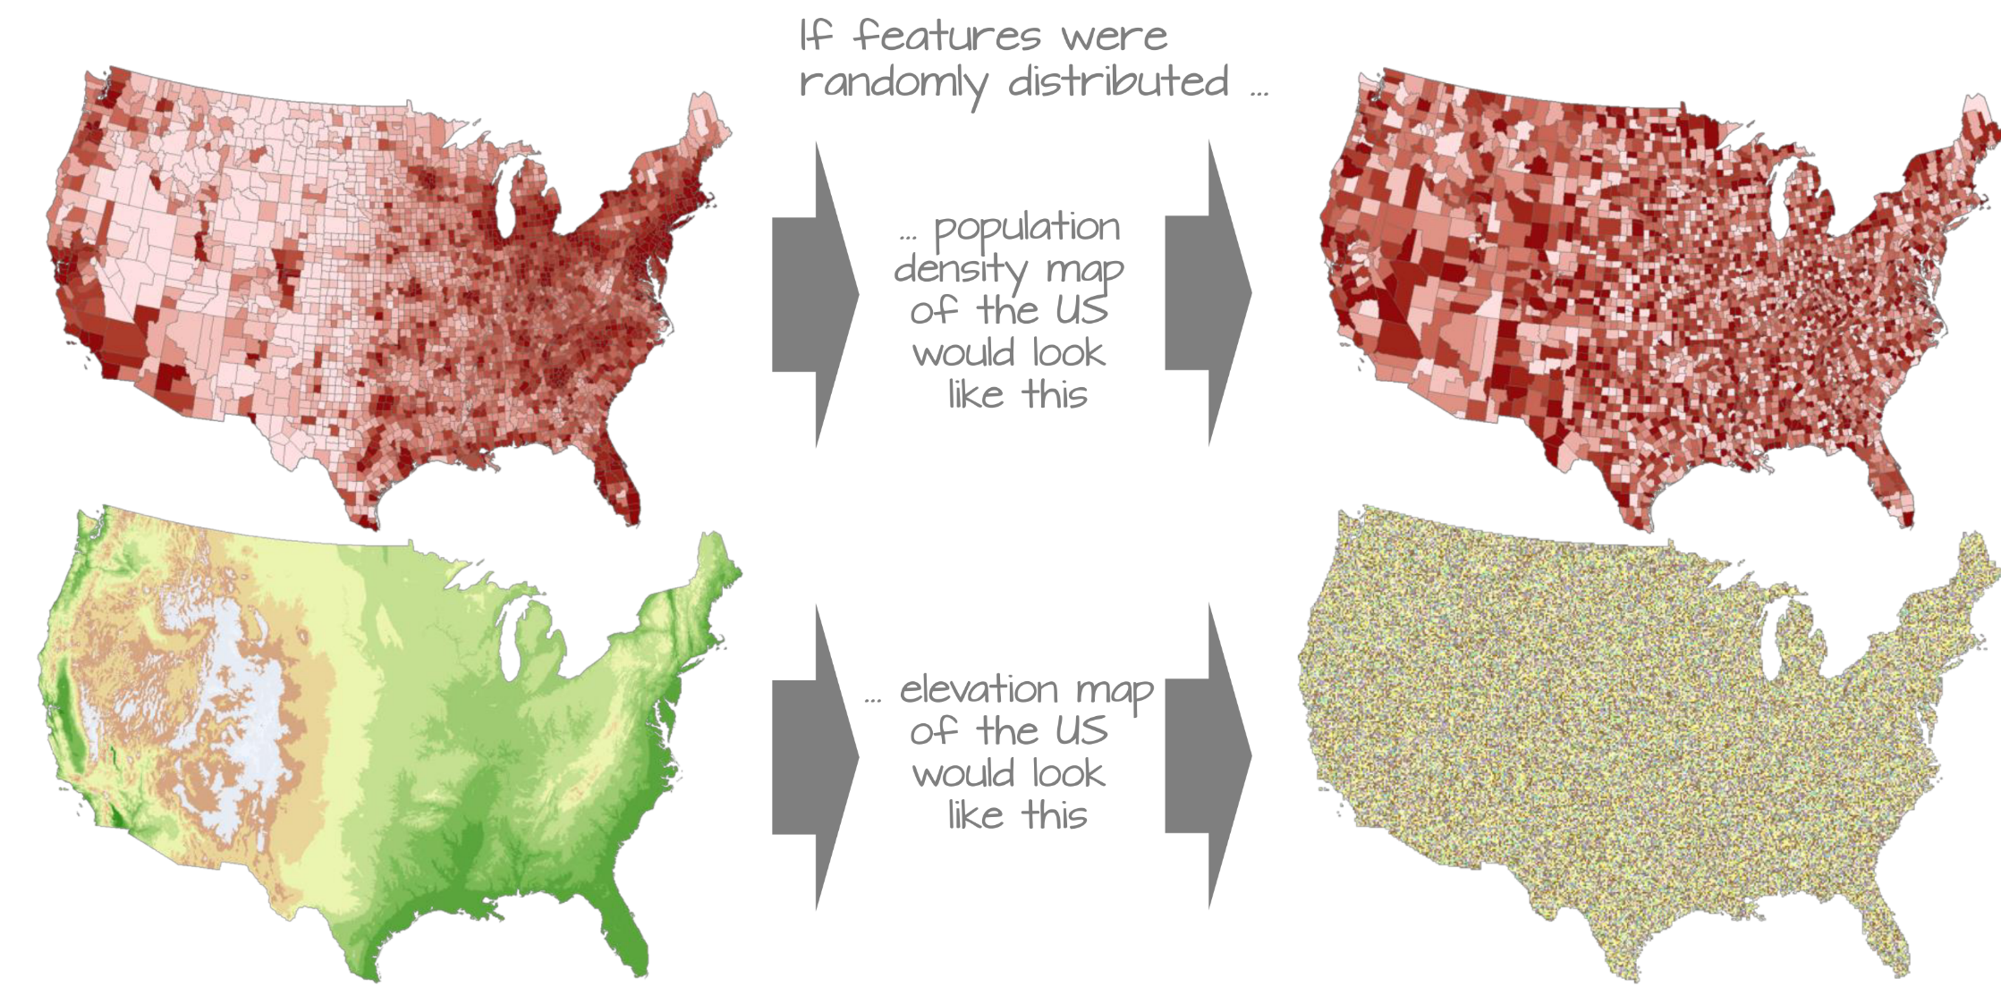
Geostatistics: Spatial variability
Spatially distributed vs Random distribution
https://mgimond.github.io/
Notes:
We must therefore come up with a quantitative and objective approach to quantifying the degree to which similar features cluster and where such clustering occurs.
One popular test of spatial autocorrelation is the Moran’s I test.
A question often asked is whether or not features with similar values are clustered, randomly distributed or dispersed.
In most cases, the distribution of attribute values will seldom show evidence of complete spatial randomness.
Though our visual senses can, in some cases, discern clustered regions from non-clustered regions, the distinction may not always be so obvious.

Slide 15
Geostatistics: Spatial variability
spatial autocorrelation
sites which are close together tend to be
more similar than those which are further apart
Task: quantitative and objective approach to quantifying the degree of clustering of similar features and where such clustering occurs
Notes:
We must therefore come up with a quantitative and objective approach to quantifying the degree to which similar features cluster and where such clustering occurs.
One popular test of spatial autocorrelation is the Moran’s I test.
A question often asked is whether or not features with similar values are clustered, randomly distributed or dispersed.
In most cases, the distribution of attribute values will seldom show evidence of complete spatial randomness.
Though our visual senses can, in some cases, discern clustered regions from non-clustered regions, the distinction may not always be so obvious.

Slide 16
Geostatistics: Regionalized variable theory
Why use regional variables theory
General analysis tool for spatially varying/dependent data
A general tool for spatial interpolation
A tool for regionalization studies
A basis for developing spatial models that consider regional differences
Notes:
https://en.wikipedia.org/wiki/Regionalized_variable_theory
“Regionalized variable theory (RVT) is a geostatistical method used for interpolation in space.[1]
The concept of the theory is that interpolation from points in space should not be based on a smooth continuous object.
It should be, however, based on a stochastic (random) model that takes into consideration the various trends in the original set of points.

Slide 17
Geostatistics: Regionalized variable theory
The concept of the theory is that interpolation from points in space should not be based on a smooth continuous object.
Notes:
Consider a digital elevation model (DEM) that shows an array of elevations of the land surface at each spatial location (i,

Slide 18
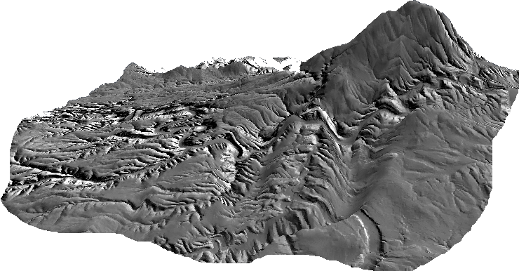
Geostatistics: Regionalized variable theory
Regionalized Variable
z(x,y)
y
Histogram of samples z_{i}
Z₃
Z₂
+
+
+
+
Z₁
Z_{n}
Z₄
+
+
Z_{i}
x
a set of space dependent values Zi => Function Z in domain D
Notes:
Consider a digital elevation model (DEM) that shows an array of elevations of the land surface at each spatial location (i,

Slide 19
Geostatistics: Regionalized variable theory
Regionalized Variable
Given a variable Z, measured at a location i, the variability in Z can be broken down into three components:
Where:
Usually removed by detrending
A “structural” coarse scale forcing (e.g. difference in mean levels) or trend
What we are interested in
Correlated variation, random local spatial dependency
error variance (normally distributed) (uncorrelated variation, noise, measurement error)
Notes:
A random local spatial dependency = spatially correlated but irregular (“random” variation)
Error variance = random uncorrelated local variation caused by measurement error and short range spatial variation
Regionalized variable theory (RVT) is a geostatistical method used for interpolation in space.
The concept of the theory is that interpolation from points in space should not be based on a smooth continuous object. It should be, however, based on a stochastic model that takes into consideration the various trends in the original set of points.
The theory considers that within any dataset, three types of relationships can be detected:
Structural part, which is also called the trend.
Correlated variation.
Uncorrelated variation, or noise.
After defining the above three relationships, RVT then applies the first law of geography, in order to predict the unknown values of points. The major application of this theory is the Kriging method for interpolation.
The theory considers that within any dataset, three types of relationships can be detected:
Structural part, which is also called the trend.
Correlated variation.
Uncorrelated variation, or noise.
After defining the above three relationships, RVT then applies the first law of geography, in order to predict the unknown values of points. The major application of this theory is the Kriging method for interpolation.”

Slide 20
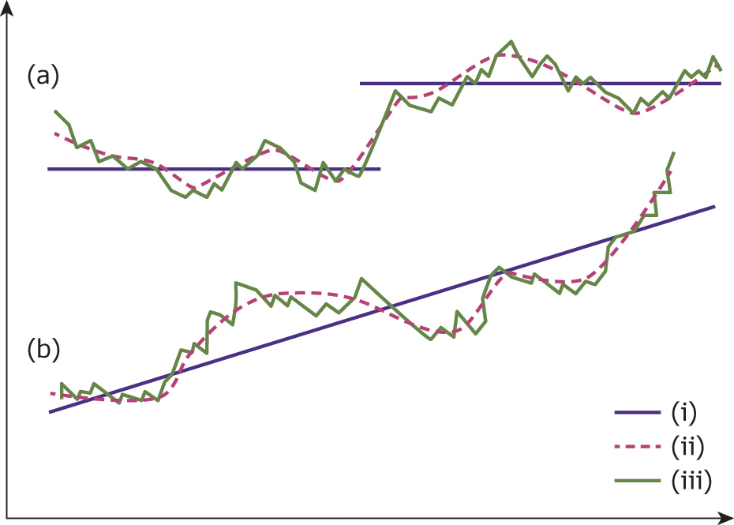
Geostatistics: Regionalized variable theory
Regionalized Variable
Given a variable Z, measured at a location i, the variability in Z can be broken down into three components:
Usually removed by detrending
Where:
A “structural” coarse scale forcing (e.g. difference in mean levels) or trend
What we are interested in
What we are interested in
Correlated variation (random local spatial dependency)
error variance (normally distributed) (uncorrelated variation, or noise)
Notes:
Regionalized variable theory divides complex spatial variation into
(i) average behaviour: difference in mean levels (a) or a trend (b)
A random local spatial dependency = spatially correlated but irregular (“random” variation)
Error variance = random uncorrelated local variation caused by measurement error and short range spatial variation
Unlike the previous methods, geostatistical methods, popularly known as kriging, can estimate both the predicted values and their standard errors. Kriging is an optimal interpolator that uses the spatial configuration and variance of the input data points to determine the interpolation weights and search radii to provide the best, unbiased estimate at unsampled locations.
Kriging method for interpolation is based on the Regionalized variable theory.
It attempts to divide the spatial variation of a variable into three components:
deterministic variation or trend;
a random but spatially correlated component (regionalised variable);
and uncorrelated noise.
It depends on the regionalised variable theory which assumes that the spatially correlated component is homogeneous (i.e. stationary) throughout the surface.
The performance of kriging relies on the presence of spatial autocorrelation – meaning that sites which are close together tend to be more similar than those which are further apart.
The nature of the regionalised variable is described by the semivariogram function which is used to optimise the interpolation weights and search radii.
The semivariogram is created from the input data points by plotting the semivariance, y(h), against the distance between the pairs of points (h) (Equation 2). For a stationary spatial process, the semivariogram would have a distinctive shape as shown in Figure 2. Different models (e.g. spherical, Gaussian, exponential and linear) can be fitted to the semivariogram and that which gives the best fit chosen for the purpose of prediction.

Slide 21
Geostatistics: Regionalized variable theory
Regionalized Variable
Given a variable Z, measured at a location i, the variability in Z can be broken down into three components:
Usually removed by detrending
Where:
A “structural” coarse scale forcing (e.g. difference in mean levels) or trend
What we are interested in
What we are interested in
Correlated variation (random local spatial dependency)
error variance (normally distributed) (uncorrelated variation, or noise)
Notes:
Regionalized variable theory divides complex spatial variation into
(i) average behaviour: difference in mean levels (a) or a trend (b)
A random local spatial dependency = spatially correlated but irregular (“random” variation)
Error variance = random uncorrelated local variation caused by measurement error and short range spatial variation
Unlike the previous methods, geostatistical methods, popularly known as kriging, can estimate both the predicted values and their standard errors. Kriging is an optimal interpolator that uses the spatial configuration and variance of the input data points to determine the interpolation weights and search radii to provide the best, unbiased estimate at unsampled locations.
Kriging method for interpolation is based on the Regionalized variable theory.
It attempts to divide the spatial variation of a variable into three components:
deterministic variation or trend;
a random but spatially correlated component (regionalised variable);
and uncorrelated noise.
It depends on the regionalised variable theory which assumes that the spatially correlated component is homogeneous (i.e. stationary) throughout the surface.
The performance of kriging relies on the presence of spatial autocorrelation – meaning that sites which are close together tend to be more similar than those which are further apart.
The nature of the regionalised variable is described by the semivariogram function which is used to optimise the interpolation weights and search radii.
The semivariogram is created from the input data points by plotting the semivariance, y(h), against the distance between the pairs of points (h) (Equation 2). For a stationary spatial process, the semivariogram would have a distinctive shape as shown in Figure 2. Different models (e.g. spherical, Gaussian, exponential and linear) can be fitted to the semivariogram and that which gives the best fit chosen for the purpose of prediction.

Slide 22
Geostatistics: Regionalized variable theory
Geostatistical methods: divide the spatial variation of a variable into three components
a deterministic model m(x,y)
a regionalised statistical (spatially correlated) variation from m(x,y)
It is defined by analysing the semivariance, γ
Semivariance is a measure of the spatial dependence between two observations as a function of the distance between them
a random noise (normal error) component
Notes:
We have to define the above three relationships, RVT then applies the first law of geography, in order to predict the unknown values of points.
The major application of this theory is the Kriging method for interpolation.

Slide 23
Learning Objectives
1
2
3
What is Geostatistics
Regionalized variable theory
Kriging
Spatial variation
Semivariogram
Basic statistic concept
Kriging in ArcGIS
Summary
Today’s topics
Notes:
spatial autocorrelation – meaning that sites which are close together tend to be more similar than those which are further apart.

Slide 24

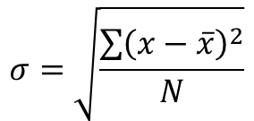
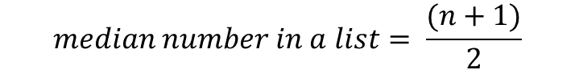
Geostatistics: measures of variability
Let’s review some (not necessarily spatial) statistics
Arithmetic Mean
Example: mean of (7,1,5,2,8) = 7 + 1 + 5 + 2 + 8 = 23/5 = 4.6
Median (the middle value in a group of numbers)
Example: median of (1, 2, 5, 7, 8) = (5+1)/2 = 5 = 3rd Number. *if there are an even number of numbers, take the mean of the middle two
Min/Max are just what they sound like, the highest and lowest value in a set
Standard Deviation (a measure of how spread out/scattered the data are from the mean)
Example: standard deviation of (7,1,5,2,8); we know the mean is 4.6
(7 –4.6)²+(1–4.6)²+ (5 -4.6)²+ (2 –4.6)²+ (8 –4.6)²= 37.2
Square root (37.2 /5) = 2.73
$$\overline{x}= \frac{x_{1}+x_{2}+x_{3}+…+x_{n}}{n}$$
$$median number in a list= \frac{(n+1)}{2}$$
$$σ=\sqrt{\frac{\sum{{\left(x−\overline{x}\right)}^{2}}}{N}}$$
Notes:
The mean of a data set is simply the arithmetic average of the values in the set, obtained by summing the values and dividing by the number of values.
In statistics, the standard deviation is a measure of the amount of variation or dispersion of a set of values.[1] A low standard deviation indicates that the values tend to be close to the mean (also called the expected value) of the set, while a high standard deviation indicates that the values are spread out over a wider range. Standard deviation may be abbreviated SD, and is most commonly represented in mathematical texts and equations by the lower case Greek letter σ (sigma), for the population standard deviation, or the Latin letter s, for the sample standard deviation.
The normal distribution has several interesting characteristics.
The shape of the distribution is determined by the average, X, and the standard deviation, s. The highest point on the curve is the average. The distribution is symmetrical about the average. Most of the area under the curve (99.7%) lies between -3s and +3s of the average. In addition, about 95.44% of the curve is between -2s and +2s of the average, while 68.26% of the curve is between -1s and +1s of the average.
Advantages of standard deviation:
Shows how much data is clustered around a mean value
It gives a more accurate idea of how the data is distributed
Not as affected by extreme values
Good estimate of variation of a data set if the distribution is normal

Slide 25

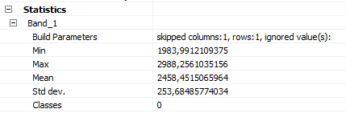
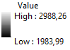
Geostatistics: measures of variability
Let’s review some (not necessarily spatial) statistics
Many of these statistics are readily accessible in ArcGIS

Slide 26
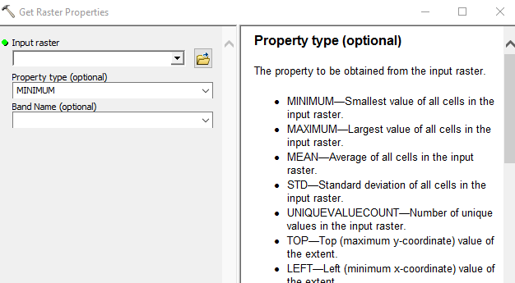
Geostatistics: measures of variability
Let’s review some (not necessarily spatial) statistics
Many of these statistics are readily accessible in ArcGIS
…and if they are not, derive them Tool: Get Raster Properties

Slide 27
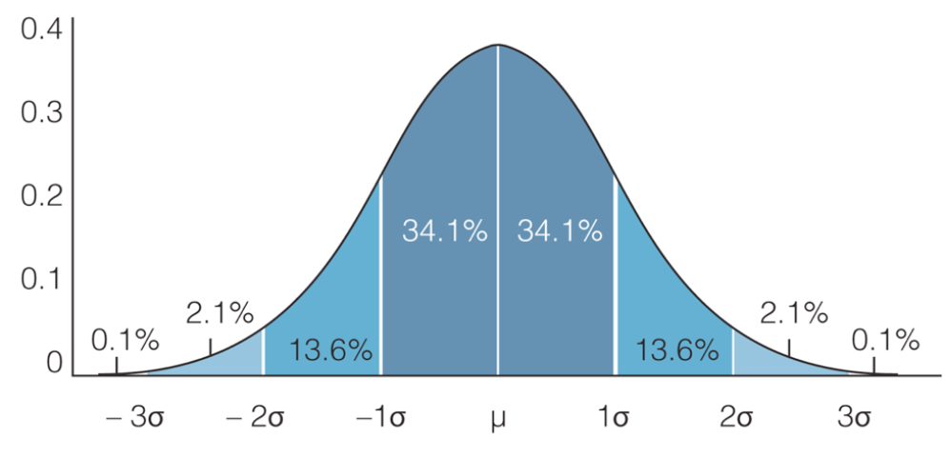
Geostatistics: measures of variability
Let’s review some (not necessarily spatial) statistics
Normal distribution
μ = mean = m
σ = standard deviation = SD
Notes:
Usually, we prefer standard deviation over variance because it is directly interpretable.
The variance and the standard deviation are both measures of the spread of the distribution about the mean.
The standard deviation is the square root of the variance
The normal distribution has several interesting characteristics.
The shape of the distribution is determined by the average, X, and the standard deviation, s. The highest point on the curve is the average. The distribution is symmetrical about the average. Most of the area under the curve (99.7%) lies between -3s and +3s of the average. In addition, about 95.44% of the curve is between -2s and +2s of the average, while 68.26% of the curve is between -1s and +1s of the average.
Advantages of standard deviation:
Shows how much data is clustered around a mean value
It gives a more accurate idea of how the data is distributed
Not as affected by extreme values
Good estimate of variation of a data set if the distribution is normal
There are three main measures of variability – variance, standard deviation and coefficient of variation. Each of them has different strengths and applications. Usually, we prefer standard deviation over variance because it is directly interpretable. However, the coefficient of variation has its edge over standard deviation when it comes to comparing data.
The mean of a data set is simply the arithmetic average of the values in the set, obtained by summing the values and dividing by the number of values.
The standard deviation is the square root of the variance
The variance and the standard deviation are both measures of the spread of the distribution about the mean. The variance is the nicer of the two measures of spread from a mathematical point of view, but as you can see from the algebraic formula, the physical unit of the variance is the square of the physical unit of the data. For example, if our variable represents the weight of a person in pounds, the variance measures spread about the mean in squared pounds. On the other hand, standard deviation measures spread in the same physical unit as the original data,
The Advantage of the Coefficient of Variation
We can divide the standard deviations by the respective means. And we get the two coefficients of variation.
When checking whether your data is normally distributed (close to a bell-shaped curve), the Histogram and Normal QQ Plots will help you. In the summary statistics provided by the Histogram, the mean and median will be similar, the skewness should be near zero, and the kurtosis should be near 3 if the data is normally distributed. If the data is highly skewed, you may choose to transform it to see if you can make it more normally distributed. Note that back transformation process generates approximately unbiased predictions with approximate kriging standard errors when you use Universal or Ordinary Kriging.
https://365datascience.com/coefficient-variation-variance-standard-deviation/

Slide 28
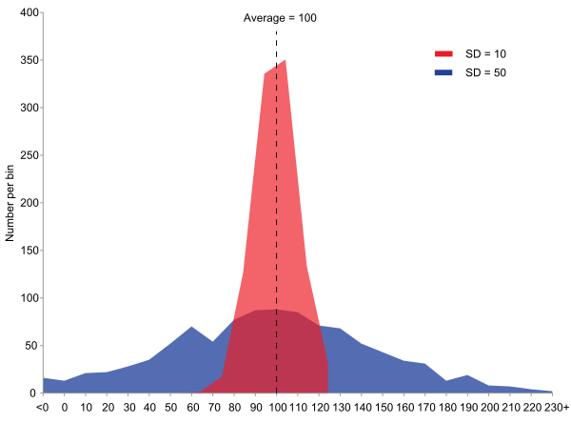
Geostatistics
Variance is the expectation E[x] of the squared deviation of a random variable x from its mean (m)
The variance is the square of the standard deviation
Var(x) = σ² = E[(x - m)²]
Definition of variance
The red population has mean 100 and variance 100 (SD=10)
the blue population has mean 100 and variance 2500 (SD=50)
Histogram of two populations with the same mean but different variances.
Notes:
Variance is calculated by taking the differences between each number in the set and the mean, squaring the differences (to make them positive) and dividing the sum of the squares by the number of values in the set.
Square of Deviation from Average
But there is a major problem with variance and that is the difficulty of interpreting the units of variance. How does one interpret squared percents?
This problem is mitigated through the use of the standard deviation. The standard deviation is the square root of the variance and is calculated as follows:
The expected value of a random variable X, denoted E(X) or E[X],
In statistics, variance is the expectation of the squared deviation of a random variable from its mean.
it measures how far a set of numbers is spread out from their average value.
The variance is the square of the standard deviation, and the covariance of the random variable with itself.
Variance: Variance is a measurement of spread or dispersion of observations within a given dataset.
Variance measures how far each observations is from mean. Dispersion of data gives the variability around the central tendency and can be calculated by the difference between largest and smallest value within dataset also known as range.

Slide 29
Geostatistics: kriging interpolation
Ordinary kriging interpolation (4 steps)
1. Removing any spatial trend in the data (if present)
2. Computing the experimental variogram, γ, which is a measure of spatial autocorrelation.
3. Defining an experimental variogram model that best characterizes the spatial autocorrelation in the data.
Interpolating the surface using the experimental variogram.
4. Adding the kriged interpolated surface to the trend interpolated surface to produce the final output.
Notes:
We have to define the above three relationships
This section will focus on ordinary kriging (OK) interpolation. This form of kriging usually involves four steps:
Removing any spatial trend in the data (if present).
Computing the experimental variogram, which is a measure of spatial autocorrelation.
Defining an experimental variogram model that best characterizes the spatial autocorrelation in the data. (linear, spherical, Gaussian et cetera)
Interpolating the surface using the experimental variogram.
Adding the kriged interpolated surface to the trend interpolated surface to produce the final output.

Slide 30
Geostatistics: kriging interpolation
1. De-trend
1st assumption:
Mean and the variation in the entity being studied (all over the domain) is constant across the study area
→ There should be no global trend in the data
If the assumption is not met
remove the trend from the data before proceeding with the kriging operations
Note: the modeled trend will be added to the kriged interpolated surface at the end of the workflow.
Notes:
One assumption that needs to be met in ordinary kriging is that the mean and the variation in the entity being studied is constant across the study area.
In other words, there should be no global trend in the data (the term drift is sometimes used to describe the trend in other texts).
This assumption is clearly not met with our Texas precipitation dataset where a prominent east-west gradient is observed. This requires that we remove the trend from the data before proceeding with the kriging operations.

Slide 31
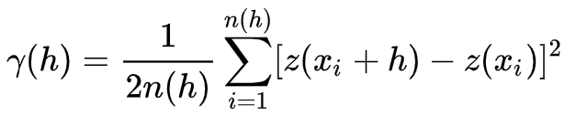
Geostatistics: kriging interpolation
2. Experimental variogram → semivariance γ
Equation:
z(x,y)
y
Z₃
Z₂
+
h
+
+
+
Where
z = attribute value at a location x,y
h is the distance between ordered data
n(h) is the number of paired data at a distance of h
Z₁
Z_{n}
Z₄
+
+
Z_{i}
x
Notes:
A random local spatial dependency = spatially correlated but irregular (“random” variation)
In spatial statistics, the semivariance (gamma) is described by this equation
where z is the attribute value
where z is a datum at a particular location, h is the distance between ordered data, and n(h) is the number of paired data at a distance of h.
The semivariance is half the variance of the increments {\displaystyle z(x_{i}+h)-z(x_{i})}, but the whole variance of z-values at given separation distance h (Bachmaier and Backes, 2008).

Slide 32
Geostatistics: kriging interpolation
2. Experimental variogram → semivariance γ
Semivariance γ is a measure of the spatial dependence between two observations as a function of the distance between them
Semivariogram: a plot of semivariances versus distances between ordered data in a graph.
2nd order stationarity:
The variance of the increment corresponding to two different locations depends only on the vector separating them.
Notes:
After the first assumption is met that means that structural effects have been accounted for, the remaining variation is homogenous in its variation, so that differences between sites are merely a function of the distance between them.
That is a called 2nd order stationarity
A plot of semivariances versus distances between ordered data in a graph is known as a semivariogram rather than a variogram.
Semivariogram - a graph of how semivariance (gamma) changes as the distance between observations changes.
Semivariograms are used for measuring the degree of dissimilarity between observations as a function of distance.

Slide 33
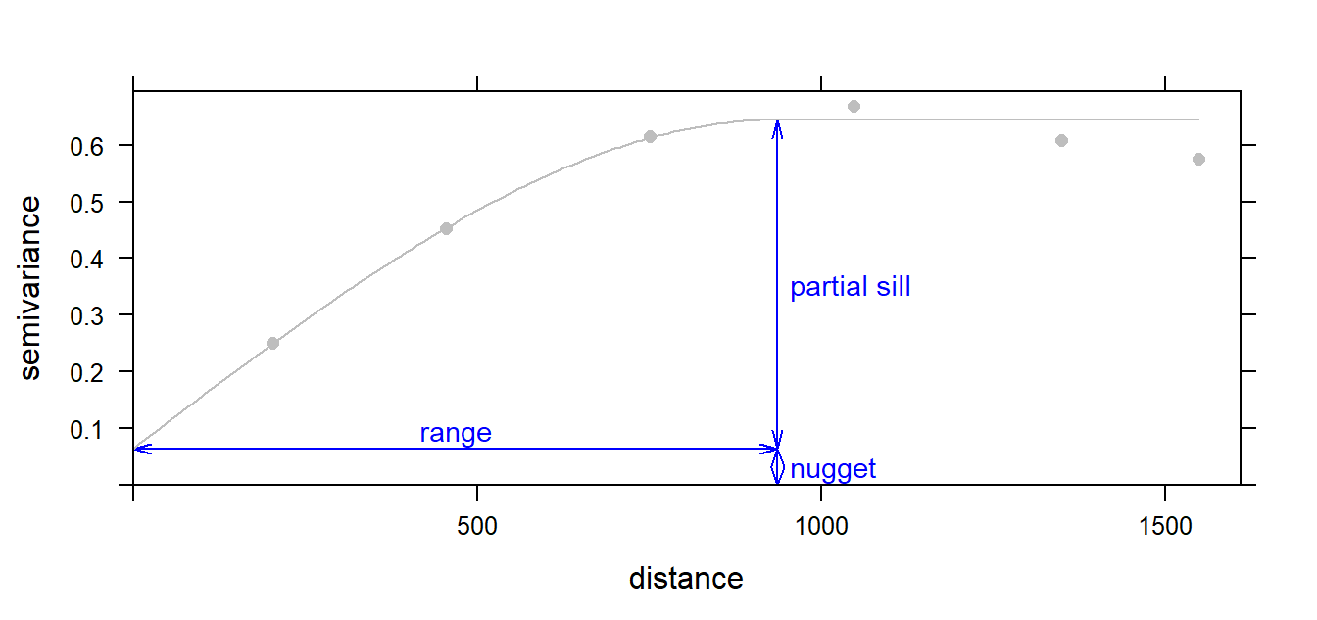
Geostatistics: kriging interpolation
Semivariogram/variogram
Partial sill is the vertical distance between the nugget and the part of the curve that levels off. If the nugget is 0 the partial sill is simply referred to as the sill.
Nugget is the distance between the 0 variance on the y axis. Indicates the random error process
Range is the distance along the x axis where the curve levels off
Semivariogram: A plot of semivariances versus distances between ordered data. The variogram is described by range, sill and nugget parameters
Notes:
Semivariograms are used for measuring the degree of dissimilarity between observations as a function of distance.
At large values of the lag, h, it levels off. This horizontal part is known as the sill; it implies that at these values of the lag there is no spatial dependence between the data points…
The nugget, the sill and the range parameters are often used to describe variograms:
Graphical description of the range, sill and nugget parameters in a variogram model.
nugget: The random error process indicated by the height of the jump of the semivariogram at the discontinuity at the origin.
sill: The limit of the variogram tending to infinity lag distances.
range: The distance in which the difference of the variogram from the sill becomes negligible.
If the distance separating an unvisited site from a data point is greater than the range, then that data point can make no useful contribution to the interpolation; it is too far away.
Semivariogram - a graph of how semivariance (gamma) changes as the distance between observations changes.
The partial sill is the vertical distance between the nugget and the part of the curve that levels off. If the variogram approaches 0 on the y-axis, then the nugget is 0 and the partial sill is simply referred to as the sill.
The distance along the x axis where the curve levels off is referred to as the range.
When the nugget variance c_{o} so dominates the local variation that the experimental variogram shows no tendency to diminish as h -> 0, the interpretation is that the data are so noisy that interpolation is not sensible.
The range of the variogram provides clear information about the size of the search window that should be used. If all data points are further away than the range, the best estimate is the general mean.
If the range is large, then long-range variation dominates: if it is small, then the major variation occurs over short distances.

Slide 34
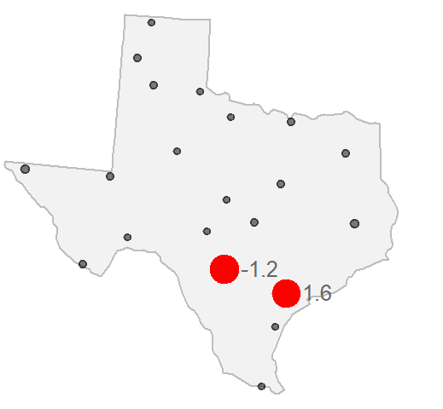
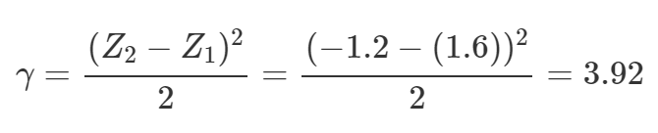
Geostatistics: kriging interpolation
2. Experimental variogram: example
We are interested in how these attribute values (precipitation residuals) vary as the distance between location point pairs increases
De-trended the surface → precipitation residuals. De-trended precipitation value is -1.2 and 1.6
Compute their difference γ
h = distance = 209 km
https://mgimond.github.io/
Notes:
In Kriging interpolation, we focus on the spatial relationship between location attribute values.
More specifically, we are interested in how these attribute values (precipitation residuals in our working example) vary as the distance between location point pairs increases.
Example with meteorological stations
We can compute the difference, γ, in precipitation values by squaring their differences then dividing by 2.
For example, if we take two meteorological stations (one whose de-trended precipitation value is -1.2 and the other whose value is 1.6),

Slide 35
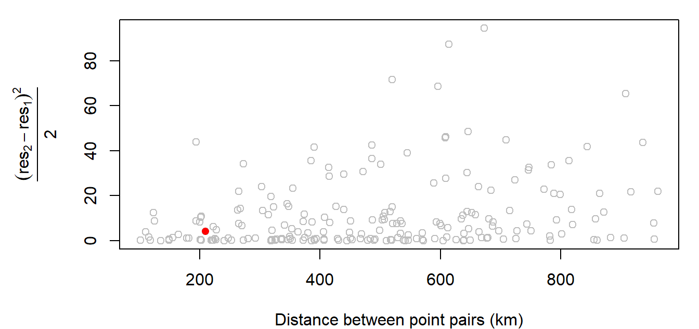
Geostatistics: kriging interpolation
2. Experimental variogram: example
Compute the difference for all point pairs
Plot these values as a function of the distances that separate these points
Experimental variogram plot of precipitation residual values
https://mgimond.github.io/
Notes:
Example with meteorological stations
The red point in the plot is the value computed in the above example.
The distance separating those two points is about 209 km. This value is mapped in 14.12 as a red dot.
It is called experimental because the points we are working with are just samples of some continuous field whose spatial variation we are attempting to model.
The above plot is called an experimental semivariogram cloud plot (also referred to as an experimental variogram cloud plot).
The terms semivariogram and variogram are often used interchangeably (BUT WHY?) in geostatistics (we’ll use the term variogram henceforth since this seems to be the term of choice in current literature).

Slide 36
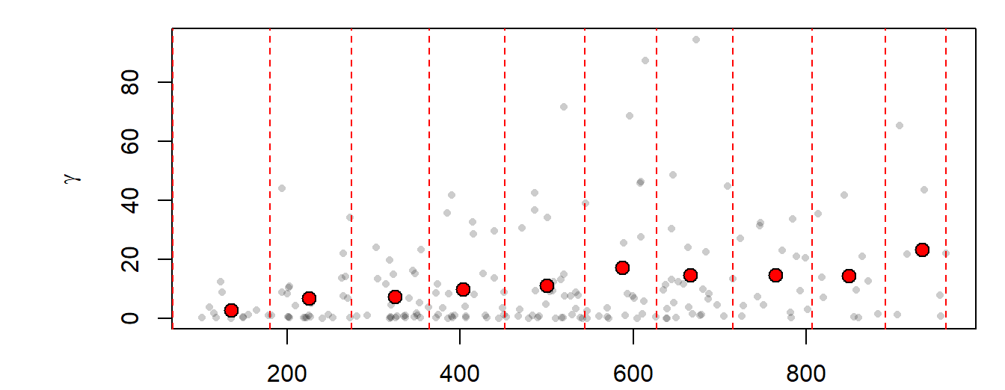
Geostatistics: kriging interpolation
2. Experimental variogram: example
Sample Experimental Variogram
Average value = sample experimental variogram estimates
lag
Sample experimental variogram plot of precipitation residual values
https://mgimond.github.io/
Notes:
Sample Experimental Variogram
Cloud points can be difficult to interpret due to the sheer number of point pairs.
A common approach to resolving this issue is to “bin” the cloud points into intervals called lags and to summarize the points within each interval.
In the following plot, we split the data into 15 bins then compute the average point value for each bin (displayed as red points in the plot). The red points that summarize the cloud are the sample experimental variogram estimates for each of the 15 distance bands and the plot is referred to as the sample experimental variogram plot.

Slide 37
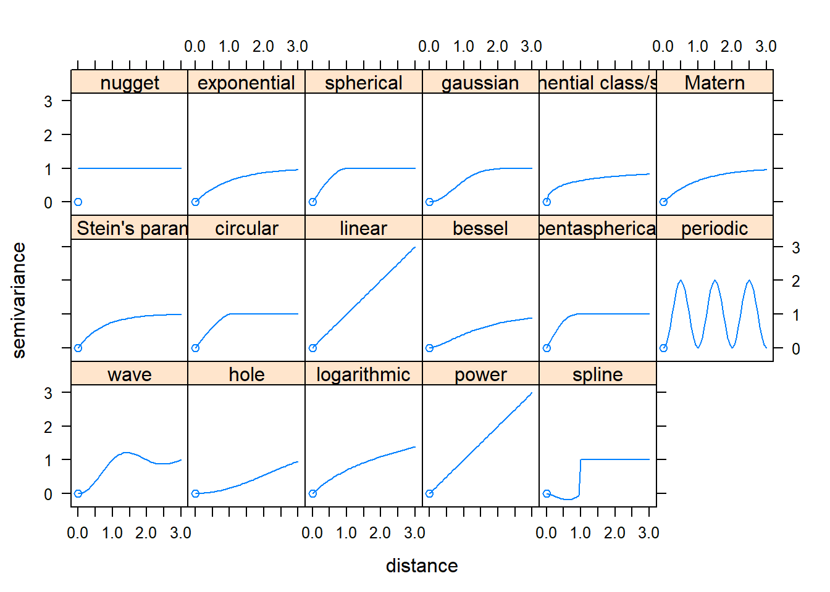
Geostatistics: kriging interpolation
3. Experimental variogram model
Fit a mathematical model to our sample experimental variogram
Different mathematical models can be used; their availability is software dependent
A subset of variogram models available
Notes:
Sample Experimental Variogram
The next step is to fit a mathematical model to our sample experimental variogram. Different models (e.g. spherical, Gaussian, exponential and linear) can be fitted to the semivariogram and that which gives the best fit chosen for the purpose of prediction.
Different mathematical models can be used; their availability is software dependent. Examples of mathematical models are shown below.
The goal is to apply the model that best fits our sample experimental variogram. This requires picking the proper model, then optimize the partial sill, range, and nugget parameters (where appropriate).
The following figure illustrates a nonzero intercept where the nugget is the distance between the 0 variance on the y axis and the variogram’s model intercept with the y axis.

Slide 38
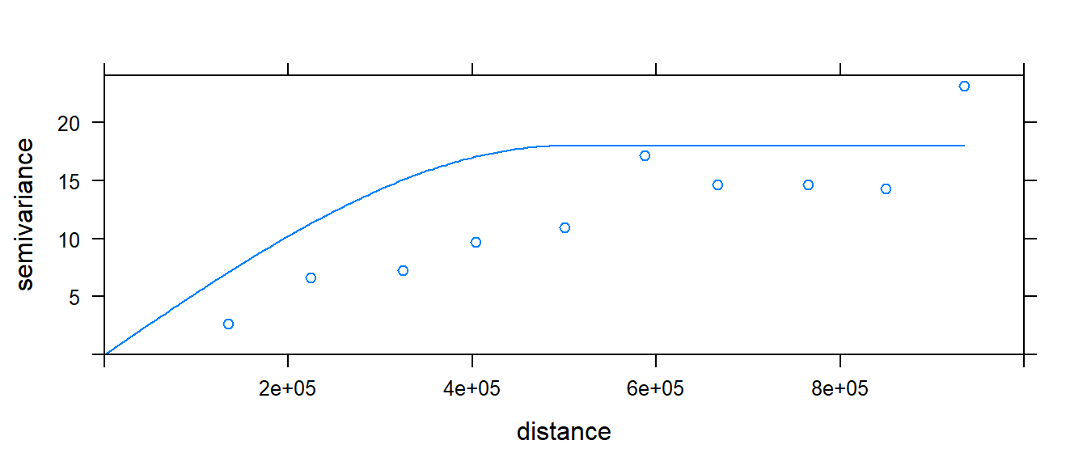
Geostatistics: kriging interpolation
3. Experimental variogram model: example
we fit the Spherical function to our sample experimental variogram
The most popular models are:
Spherical
Linear
Gaussian
A spherical model fit to our residual variogram
https://mgimond.github.io/
Notes:
In our working example, we will try to fit the Spherical function to our sample experimental variogram.
This is one of three popular models (the other two being linear and gaussian models.)

Slide 39
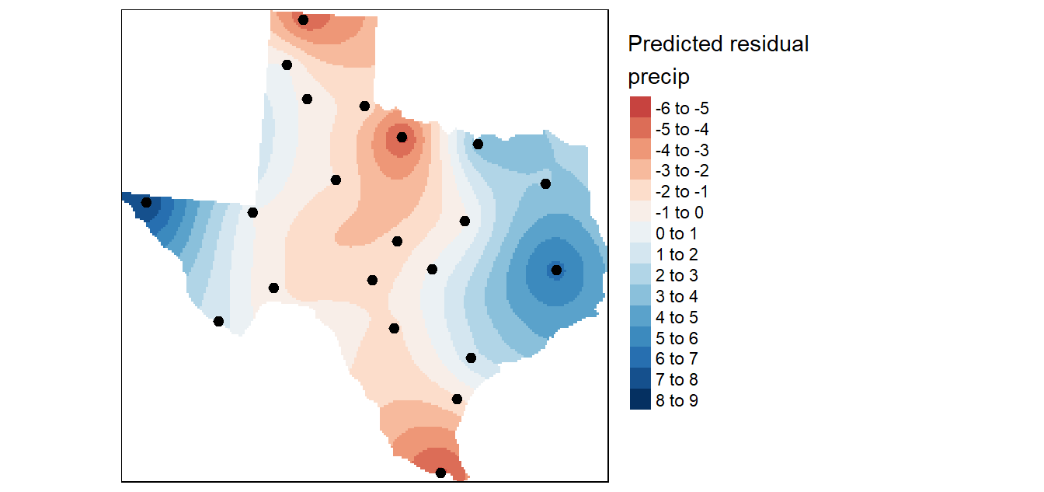
Geostatistics: kriging interpolation
4. Kriging Interpolation
The variogram model is used by the kriging interpolator to provide localized weighting parameters.
Kriging interpolation of the detrended (residual) precipitation values
https://mgimond.github.io/
Notes:
Kriging Interpolation
kriging method required a valid model of spatial variability for all distances. This is derived with a variogram model.
The variogram model is used to optimise the interpolation weights and search radius.
The variogram model is used by the kriging interpolator to provide localized weighting parameters.
Recall that with the IDW, the interpolated value at an unsampled site is determined by summarizing weighted neighboring points where the weighting parameter (the power parameter) is defined by the user and is applied uniformly to the entire study extent.
Kriging uses the variogram model to compute the weights of neighboring points based on the distribution of those values–in essence,
kriging is letting the localized pattern produced by the sample points define the weights (in a systematic way).
The exact mathematical implementation will not be covered here (it’s quite involved), but the resulting output is shown in the following figure:

Slide 40
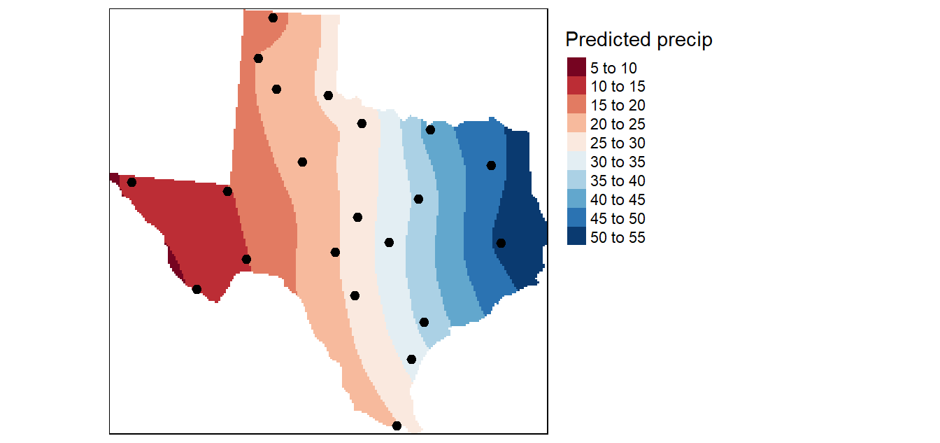
Geostatistics: kriging interpolation
4. Kriging Interpolation
Combine the interpolated surface (of the residual) with the interpolated surface produced from the trend interpolation
The final kriged surface
https://mgimond.github.io/
Notes:
Recall that the kriging interpolation was performed on the de-trended data. In essence, we predicted the precipitation values based on localized factors.
We now need to combine this interpolated surface with that produced from the trend interpolated surface to produce the following output:

Slide 41
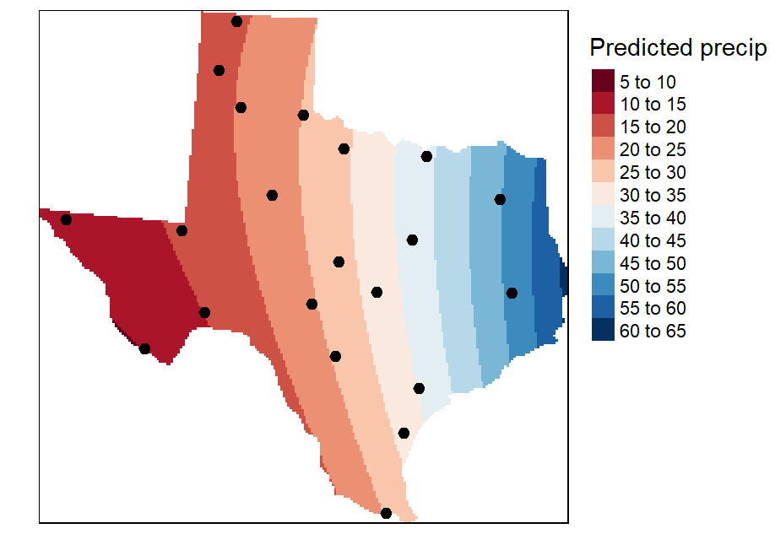
Geostatistics: kriging interpolation
Comparison Kriging and Trend Surface
Kriging
2nd Order Trend Surface
https://mgimond.github.io/

Slide 42
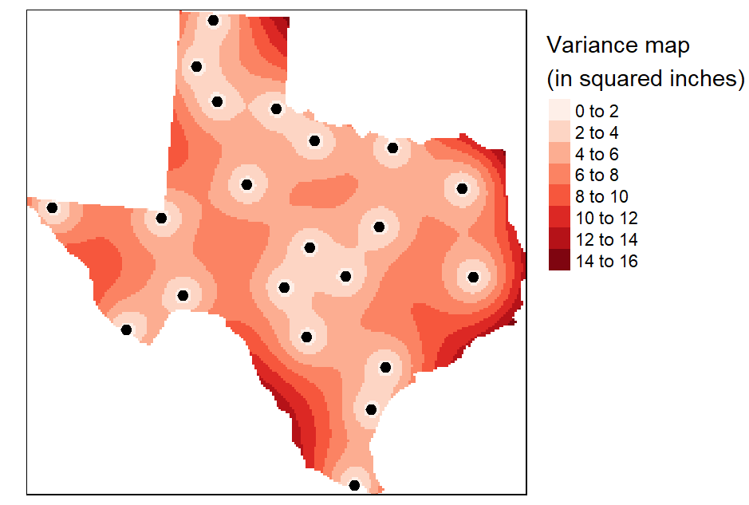
Geostatistics: kriging interpolation
Accuracy assessment: variance map
Variance map gives you a measure of uncertainty in the interpolated values.
The smaller the variance, the better (note that the variance values are in squared units).
Variance => The average distance of a set of variables from the average value in that set
1 inch = 25.4 millimeters
Variance map resulting from the Kriging analysis
https://mgimond.github.io/
Notes:
QUESTION: Do you see any trends in the distribution?
Variance = The average distance of a set of variables from the average value in that set. It is used to provide insight on the spread of a set of data,
A valuable by-product of the kriging operation is the variance map which gives us a measure of uncertainty in the interpolated values.
The smaller the variance, the better (note that the variance values are in squared units).
The variance and standard deviation (the square root of the variance, symbolized by S) are the most commonly used measures of spread.
the average squared deviation of each number from the mean of a data set
Why high or low accuracy?
Where?
Interpolation vs extrapolation

Slide 43
Learning Objectives
1
2
3
What is Geostatistics
Regionalized variable theory
Kriging
Spatial variation
Semivariogram
Basic statistic concept
Kriging in ArcGIS
Summary
Today’s topics

Slide 44
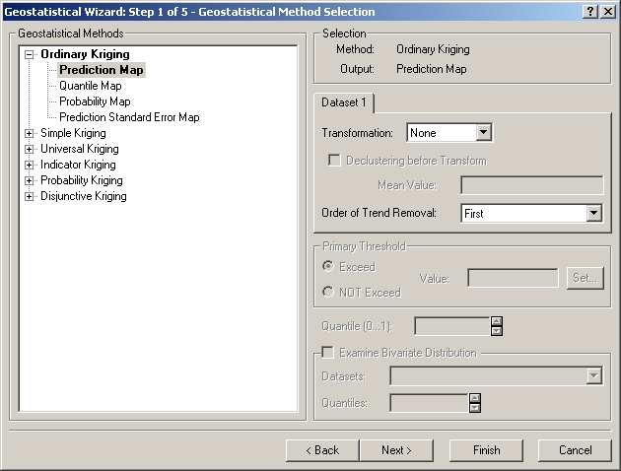
Geostatistics: kriging interpolation in ArcGIS
Removing any spatial trend in the data
Notes:
Ordinary kriging interpolation (4 steps)
Removing any spatial trend in the data (if present).
Computing the experimental variogram, γ, which is a measure of spatial autocorrelation.
Defining an experimental variogram model that best characterizes the spatial autocorrelation in the data.
Interpolating the surface using the experimental variogram.
Adding the kriged interpolated surface to the trend interpolated surface to produce the final output.

Slide 45
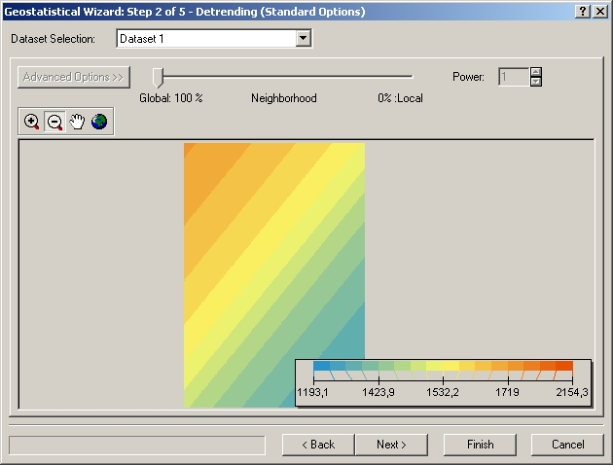
Geostatistics: kriging interpolation in ArcGIS
Detrend surface

Slide 46
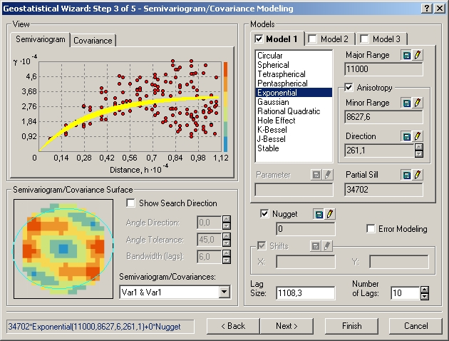
Geostatistics: kriging interpolation in ArcGIS
2. Computing the experimental variogram
3. Defining an experimental variogram model that best characterizes the spatial autocorrelation in the data.
Interpolating the surface using the experimental variogram.

Slide 47
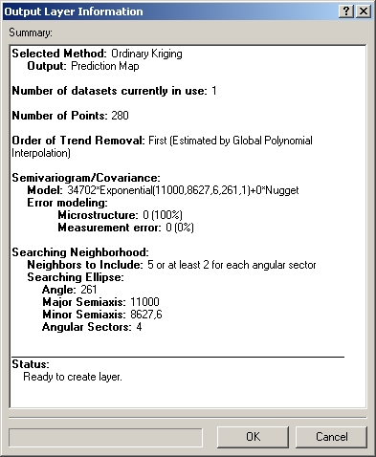
Geostatistics: kriging interpolation in ArcGIS

Slide 48
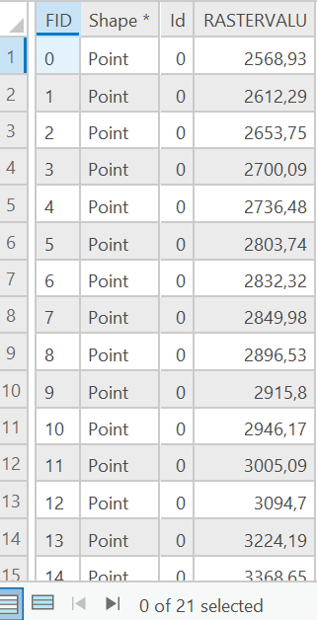
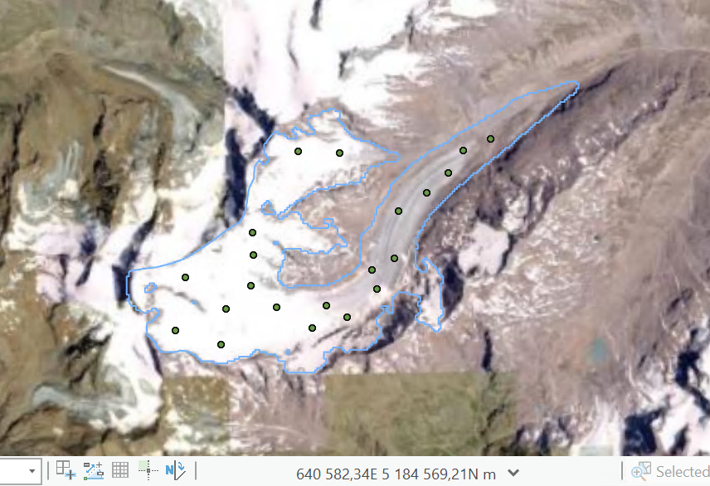
Geostatistics: kriging interpolation in ArcGISPro
Task: Interpolate the points and generate a continues elevation model (surface raster)

Slide 49
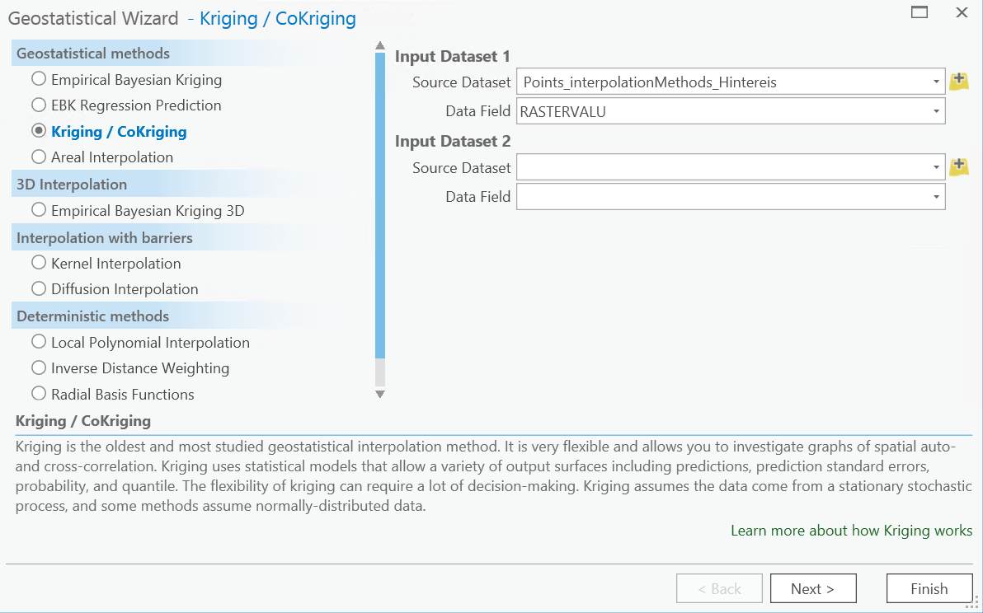
Geostatistics: kriging interpolation in ArcGISPro
Analysis
→ Geostatistical Wizard

Slide 50
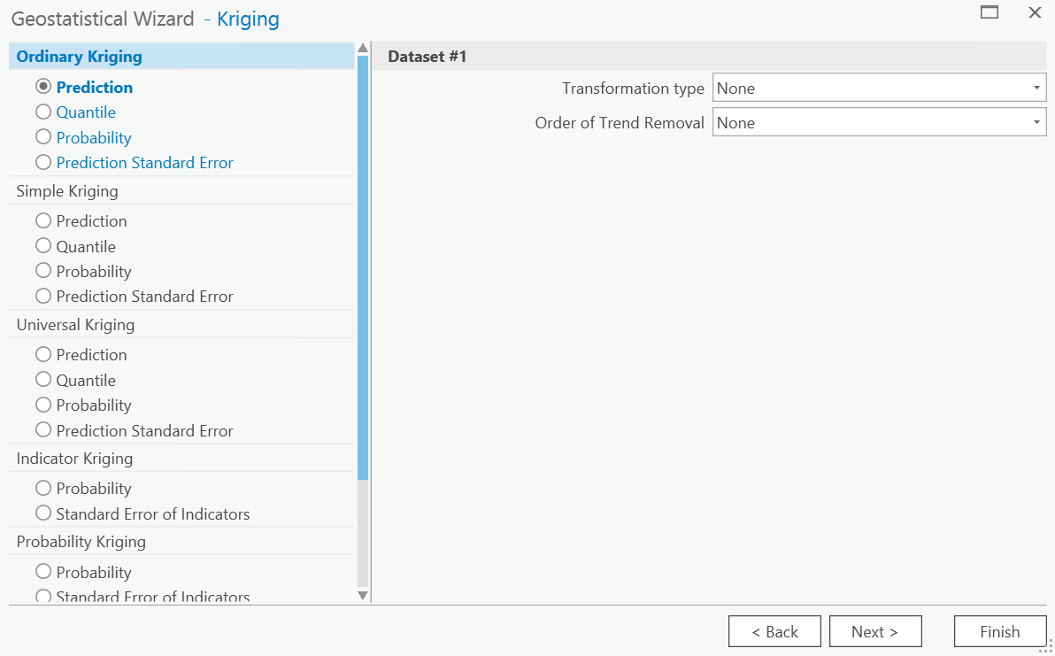
Geostatistics: kriging interpolation in ArcGISPro
Analysis
Geostatistical Wizard
Ordinary Kriging
Prediction

Slide 51
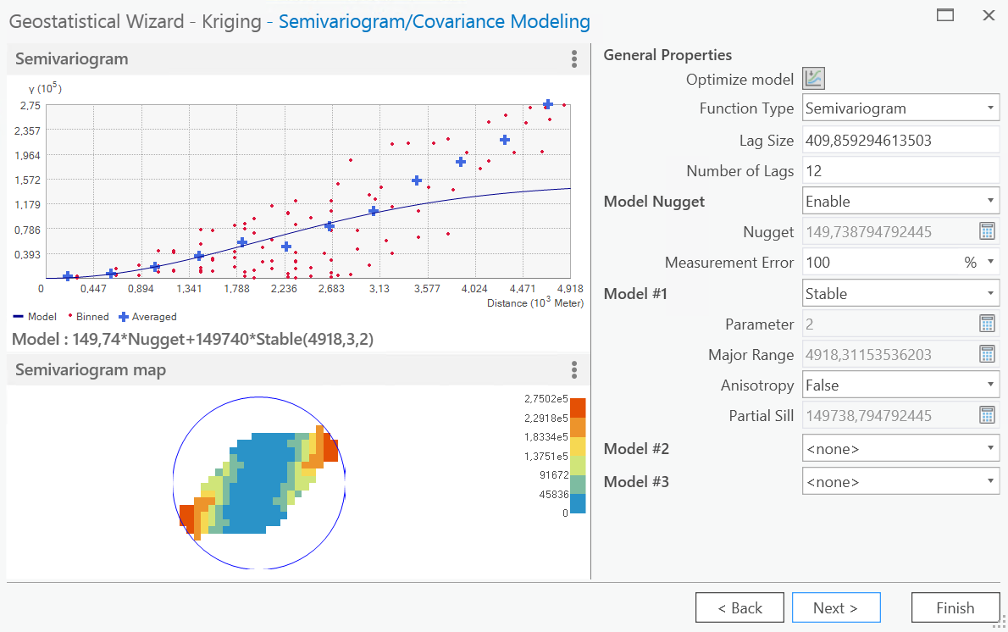
Geostatistics: kriging interpolation in ArcGISPro
Analysis
Geostatistical Wizard
Ordinary Kriging
Prediction

Slide 52
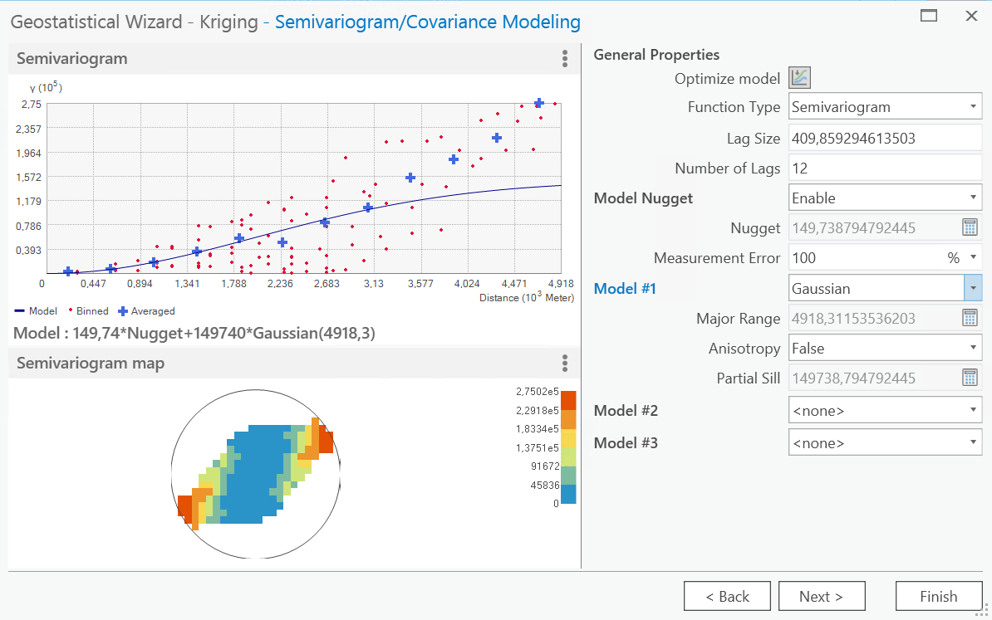
Geostatistics: kriging interpolation in ArcGISPro
Analysis
Geostatistical Wizard
Ordinary Kriging
Prediction

Slide 53
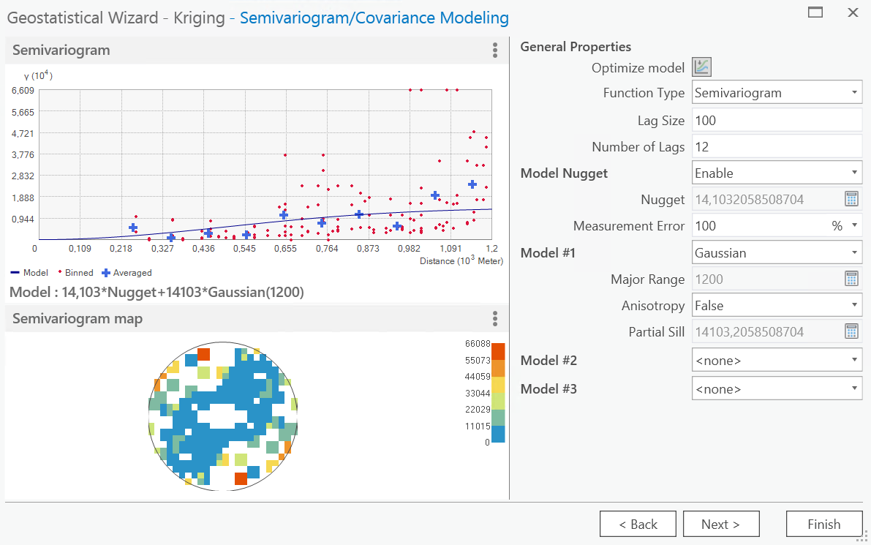
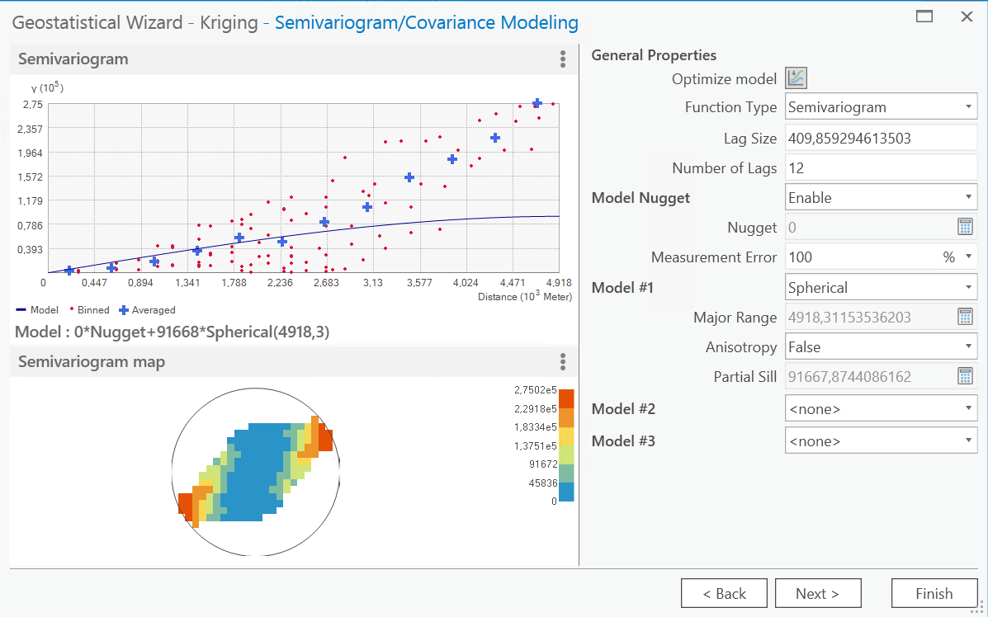
Geostatistics: kriging interpolation in ArcGISPro
Analysis
Geostatistical Wizard
Ordinary Kriging
Prediction

Slide 54

Geostatistics: kriging interpolation in ArcGISPro
Analysis
Geostatistical Wizard
Ordinary Kriging
Prediction

Slide 55
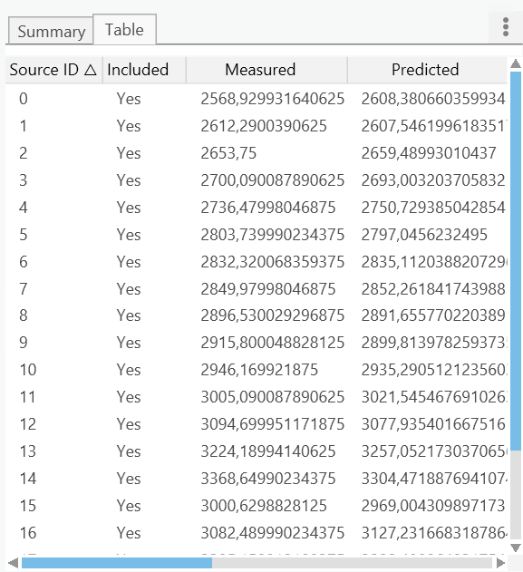
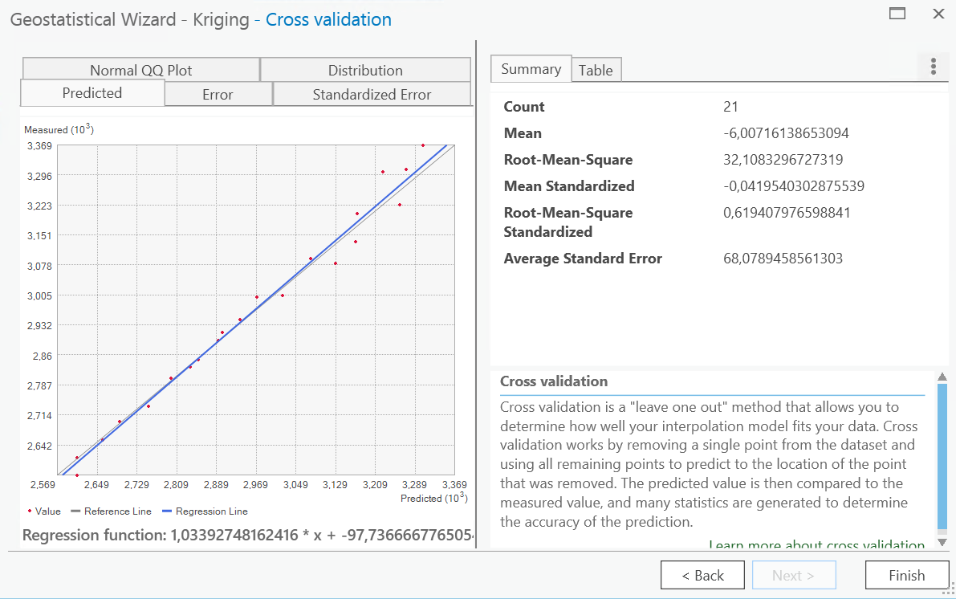
Geostatistics: kriging interpolation in ArcGISPro
Analysis
Geostatistical Wizard
Ordinary Kriging
Prediction
Notes:
Cross validation is a ”leave one out” method that allows you to determine how well your interpolation model fits your data.

Slide 56
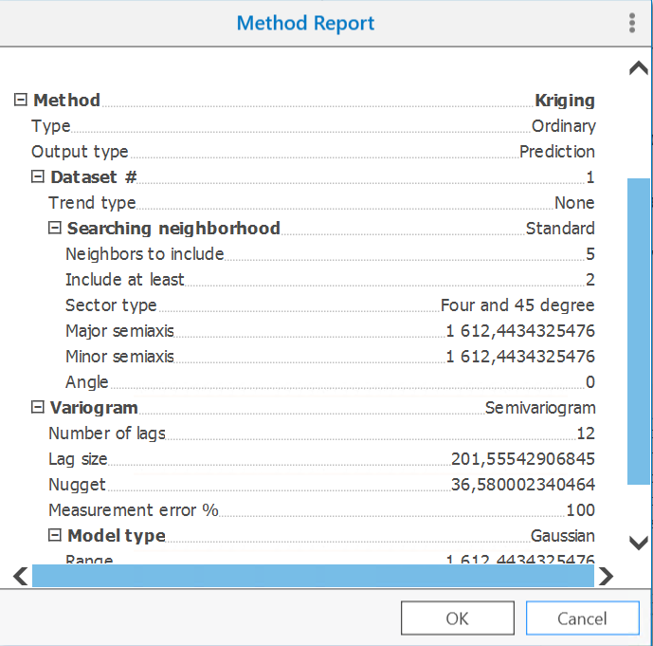
Geostatistics: kriging interpolation in ArcGISPro
Analysis
Geostatistical Wizard
Ordinary Kriging
Prediction

Slide 57
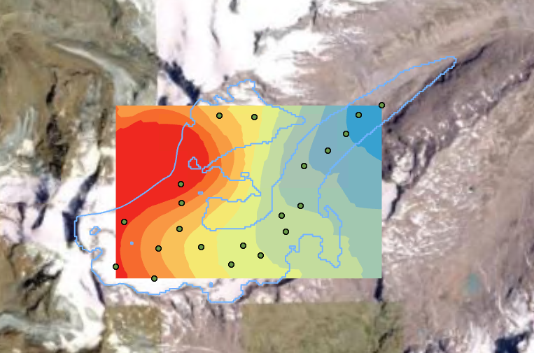
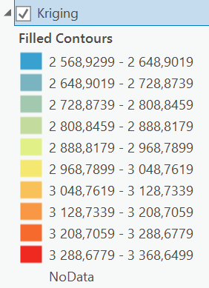
Geostatistics: kriging interpolation in ArcGISPro
Analysis
Geostatistical Wizard
Ordinary Kriging
Prediction

Slide 58
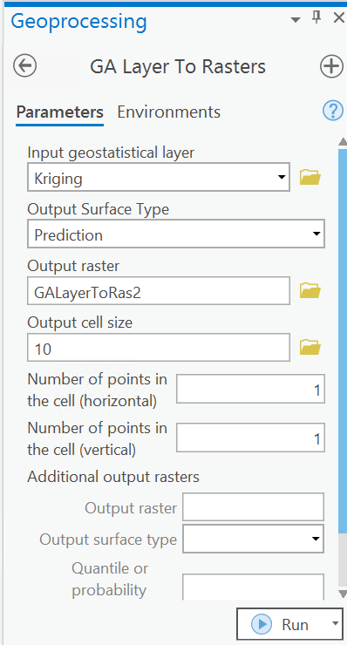
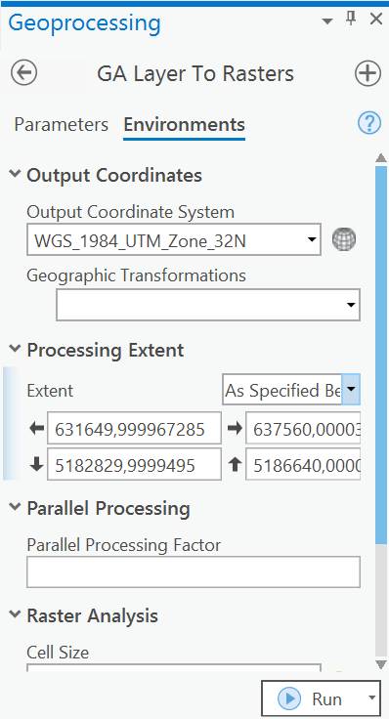
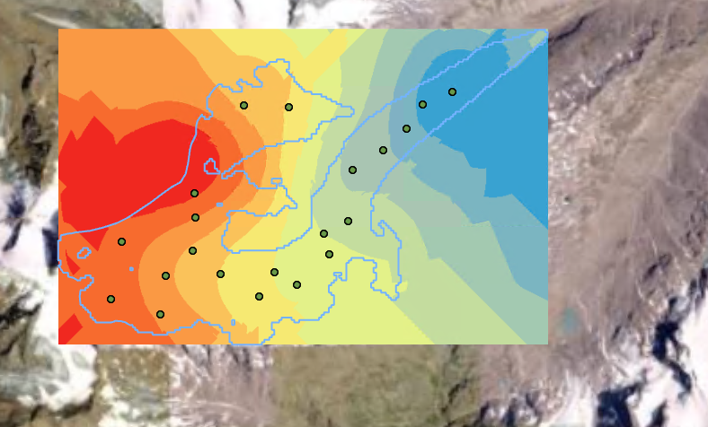
Geostatistics: kriging interpolation in ArcGISPro
Analysis
Geostatistical Wizard
Ordinary Kriging
Prediction
Export Layer
To raster
Ordinary Kriging

Slide 59
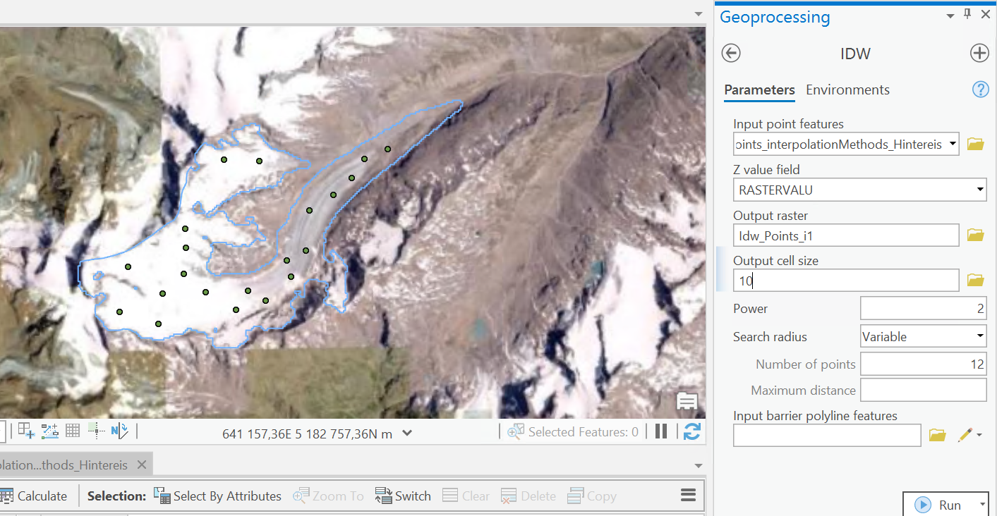
Geostatistics: kriging interpolation in ArcGISPro
Analysis
Geoprocessing
IDW
POWER (COEFFIECIENT)= how much weight do you give to the nearest neighbour point close to what we try to interpolate?
Notes:
Q: What are the differences between these two?

Slide 60
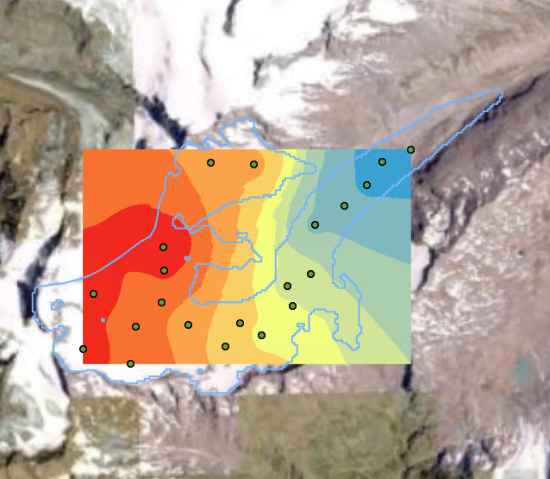
Geostatistics: kriging interpolation in ArcGISPro
IDW
Kriging
Analysis
Geoprocessing
IDW
POWER (COEFFICIENT)= how much weight do you give to the nearest neighbour point close to what we try to interpolate?
Notes:
Duck egg

Slide 61
Summary: Regionalised variable
The nature of the regionalised variable is described by the semivariogram function
The semivariogram is created from the input data points by plotting the semivariance, y(h), against the distance between the pairs of points (h)
Semivariogram is used to optimise the interpolation weights and search radius.
Different models (e.g. spherical, Gaussian, exponential and linear) can be fitted to the semivariogram and that which gives the best fit chosen for the purpose of prediction.

Slide 62
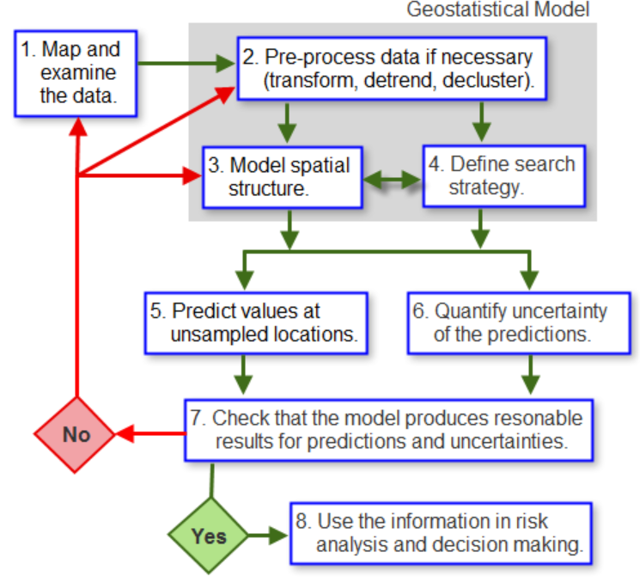

Summary: Spatial variability
Geostatistics tools and methods
Provide interpolated values (predictions for unsampled locations)
Provide measures of uncertainty for those values (prediction)
Notes:
https://pro.arcgis.com/en/pro-app/latest/help/analysis/geostatistical-analyst/the-geostatistical-workflow.htm
Lets start to have a look on Geostatistical workflow
Geostatistical models can be applied to a wide variety of scenarios and are typically used to generate predictions for unsampled locations,
as well as measures of uncertainty for those predictions.
1. The first step, as in almost any data-driven study, is to closely examine the data.
This typically starts by mapping or plotting the dataset, using a classification and color scheme that allow clear visualization of important characteristics that the dataset might present, for example, a strong increase in values from north to south or a mix of high and low values in no particular arrangement (possibly a sign that the data was taken at a scale that does not show spatial correlation).
2. The second stage is to build the geostatistical model. This process can entail several steps, depending on the objectives of the study (that is, the types of information the model is supposed to provide) and the features of the dataset. Building the model can involve preprocessing the data to remove spatial trends, which are modeled separately and added back in the final step of the interpolation process. It might also involve transforming the data so that it follows a Gaussian distribution more closely.
3. In addition to preprocessing the data, it may be necessary to model the spatial structure (spatial correlation) in the dataset.
Some methods, such as kriging, require this to be explicitly modeled using semivariogram or covariance functions whereas other methods, such as Inverse Distance Weighting, rely on an assumed degree of spatial structure, which the modeler must provide based on prior knowledge of the phenomenon.
4. A final component of the model is the search strategy. This defines how many data points are used to generate a value for an unsampled location. Their spatial configuration (location with respect to one another and to the unsampled location) can also be defined. Both factors affect the interpolated value and its associated uncertainty.
For many methods, a search ellipse is defined, along with the number of sectors the ellipse is split into and how many points are taken from each sector to make a prediction.
5. Once the model has been completely defined, it can be used in conjunction with the dataset to generate interpolated values for all unsampled locations within an area of interest.
The output is usually a map showing values of the variable being modeled. The effect of outliers can be investigated at this stage, as they will probably change the model's parameter values and thus the interpolated map.
6. Depending on the interpolation method, the same model can also be used to generate measures of uncertainty for the interpolated values. Not all models have this capability, so it is important to define at the start if measures of uncertainty are needed.
7. As with all modeling, the model's output should be checked, that is, make sure that the interpolated values and associated measures of uncertainty are reasonable and match your expectations.
8. Once the model has been satisfactorily built, adjusted, and its output checked, the results can be used in risk analyses and decision making.

Slide 63

Thanks!
Feedback questions

